Slide 1
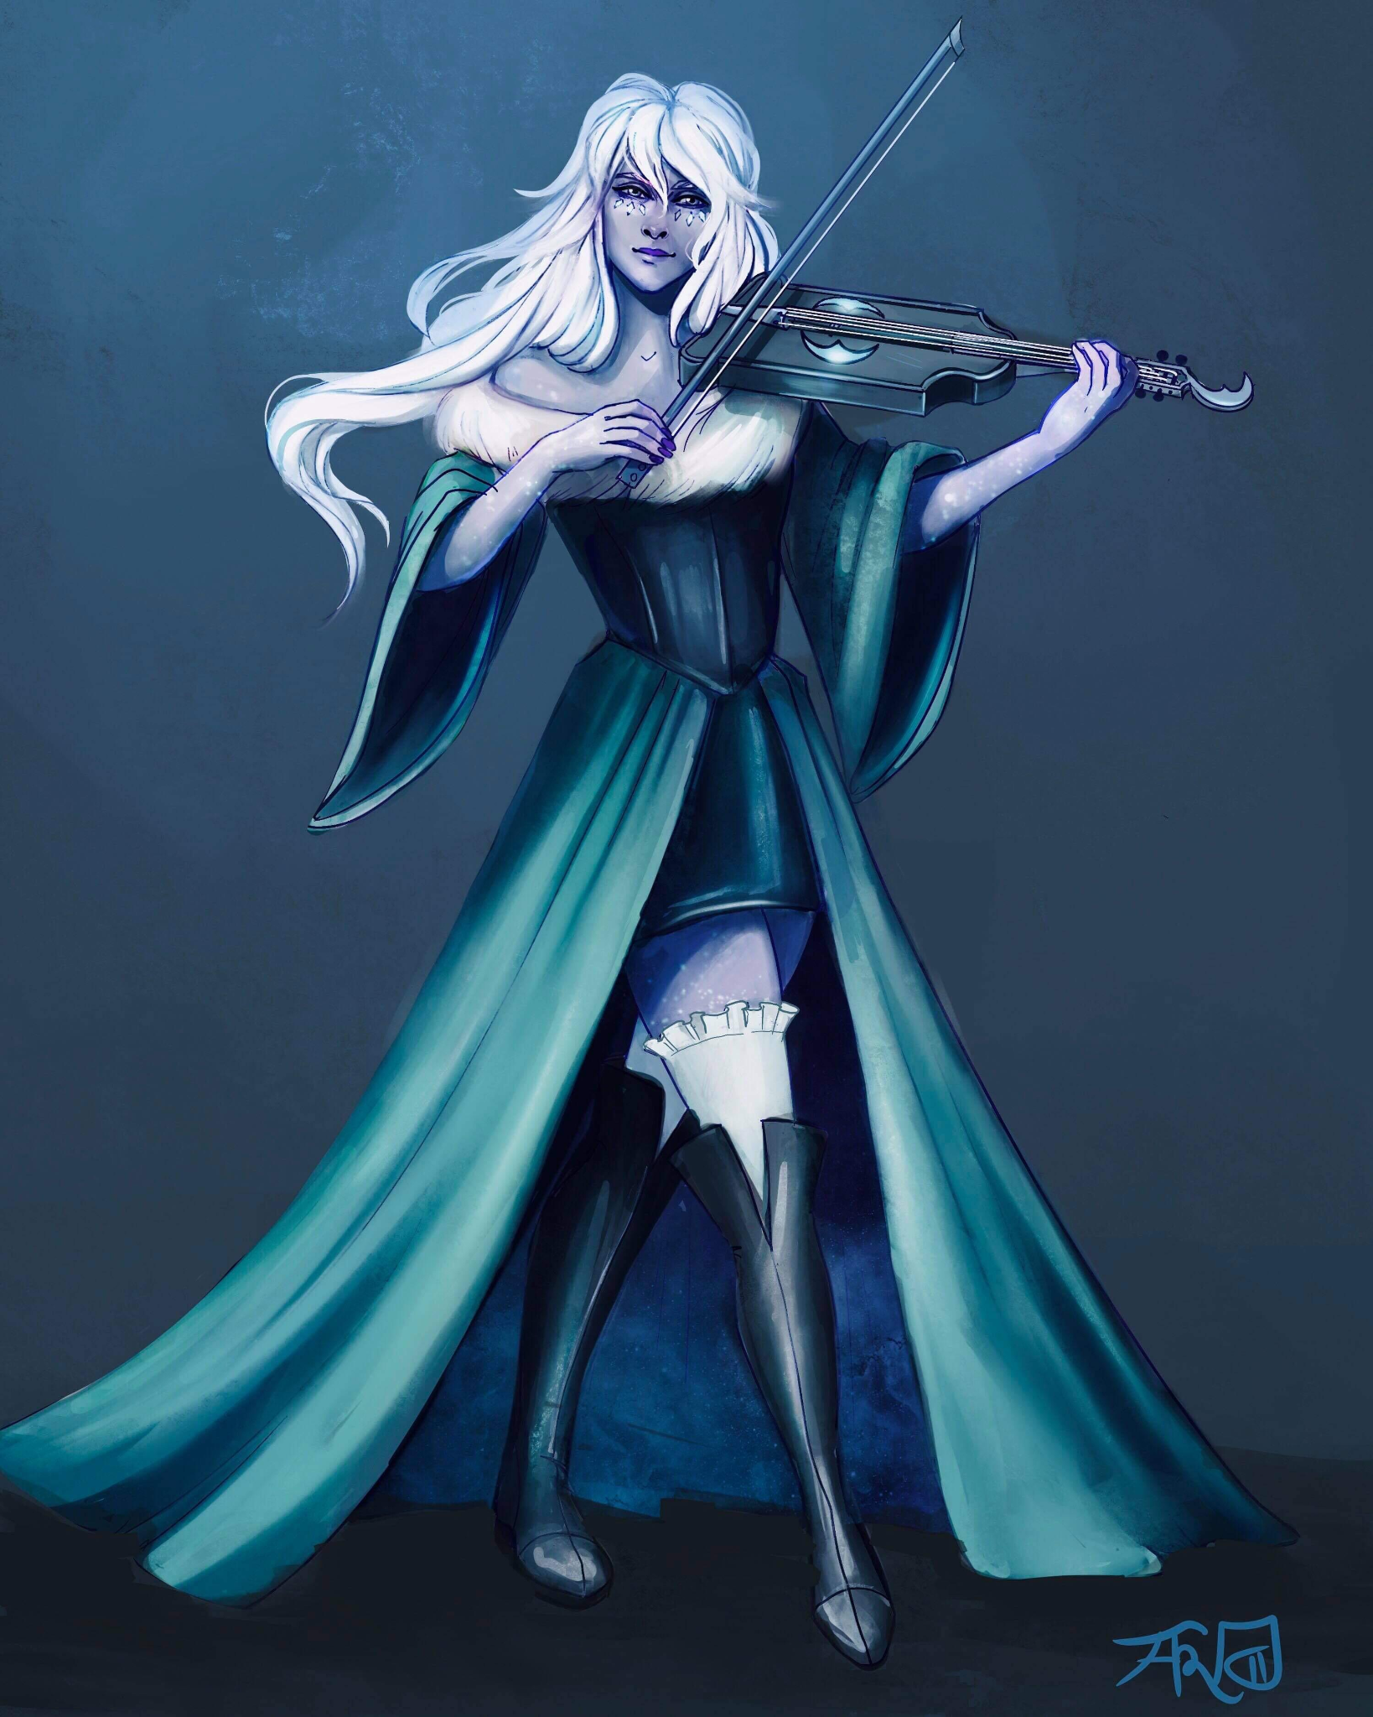
Bethany de Bolbec
Half Elf
Assistant at the Day Dream Library
Loves to play Viola and wants to prove her worth by joining the Flatcoat Circus.
Currently in a relationship with Desparia.
Currently Missing
Notes:
1 - Bethany
2 - Penguin
3 - Whistle
4 - Marbl
5 - Beverly
6 - Sunseer
7- Rhino
8 - Ramora
9 - Godiva
10 - Kyle
11 - Swan
12 - Luanda

Slide 2
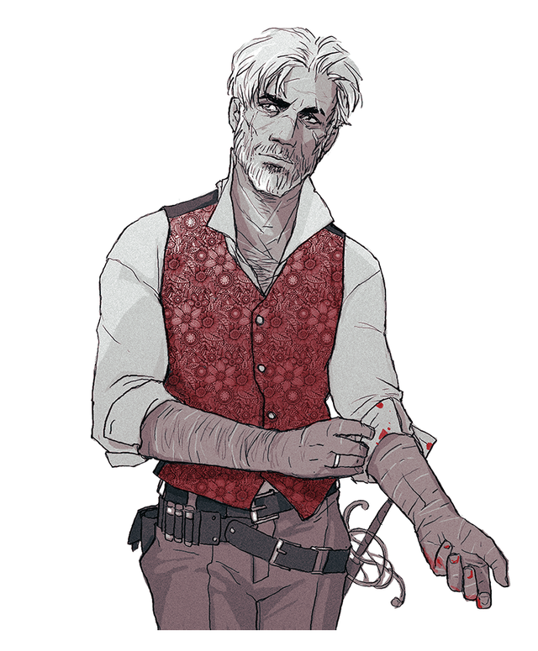
Penguin Varaati/???
Half-Elf
Adopted brother of Rhino’s Family
Very protective over Rhino, and good at calming him down.
Warlock gaining power from the left hand to Verrona’s God.
Level 3 - Warlock
STR | DEX | CON | INT | WIS | CHA
11 (+0) | 18 (+4) | 12 (+1) | 17 (+3) | 12 (+1) | 19 (+4)

Slide 3
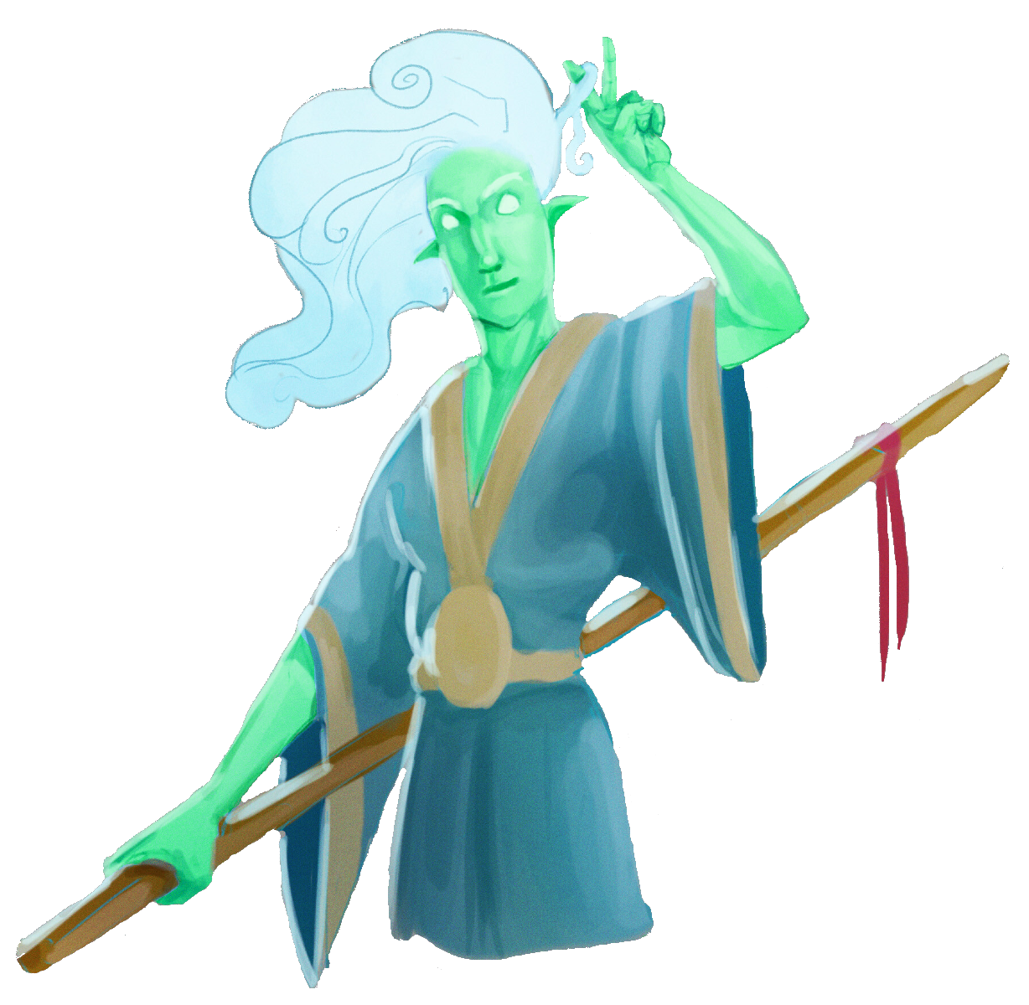
Whistle
Wind Genasi
Met at the White Basin Hotel
Adventuring with Marble
Fought off Rampaging Rhino.
Level 3 - Rogue
STR | DEX | CON | INT | WIS | CHA
10 (+0) | 14 (+2) | 14 (+2) | 11 (+0) | 11 (+0) | 12 (+1)

Slide 4
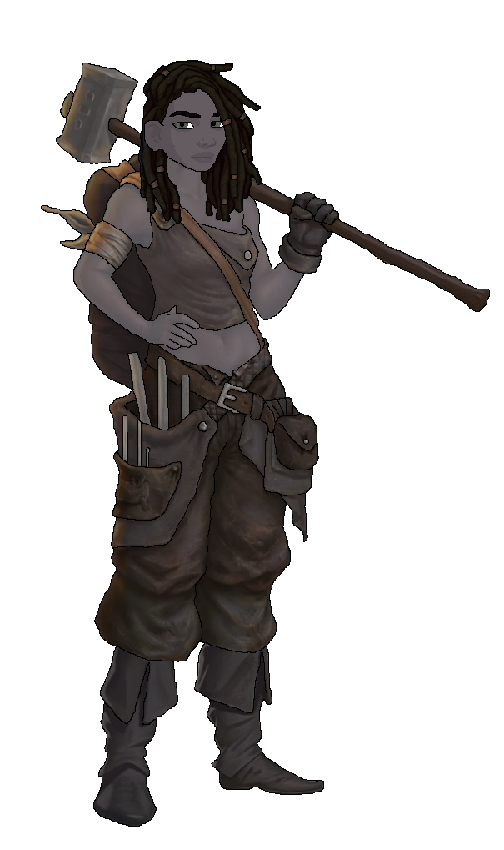
Marble
Half Orc
Met at the White Basin Hotel
Adventuring with Whistle
Fought off Rampaging Rhino.
Level 3 - Fighter
STR | DEX | CON | INT | WIS | CHA
16 (+3) | 13 (+1) | 17 (+3) | 11 (+0) | 6 (-2) | 12 (+1)

Slide 5
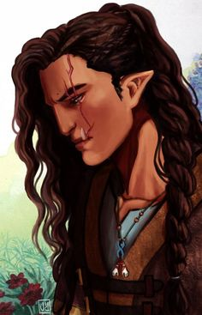
Beverly Caskbow
Half Orc
Owner of the Flowing Hammer
Got her scar from the Helmfield Cave
Joined you in the Helmfield Cave.
Scared to go out on more adventures and is comfortable working as a blacksmith
Level 3 - Barbarian
STR | DEX | CON | INT | WIS | CHA
19 (+4) | 8 (-1) | 19 (+4) | 7 (-2) | 7 (-2) | 10 (+0)

Slide 6
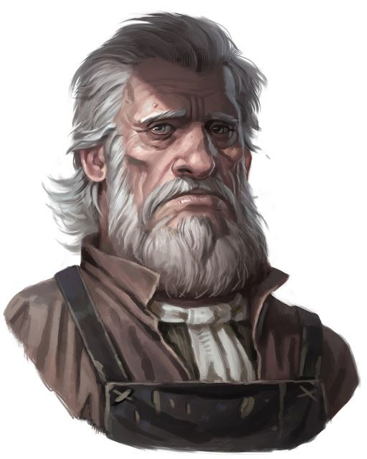
Sunseer Leonhard
Human
Owner of the White Basin Hotel
Upset due to the loss of his lovely wife but wants to try and move on.
In a relationship with Hydrangea.

Slide 7
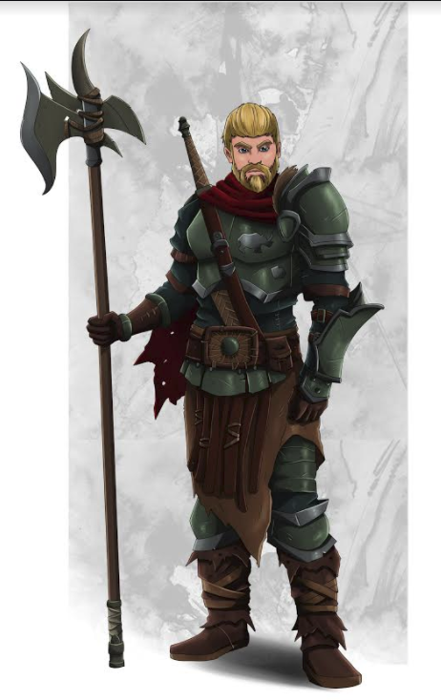
Rhino Varaati
Human
Ex-Arm Wrestling Champion of Helmfield
Depressed due to the current state of his life
Family took in Penguin as a child and raised him as their own.
Got crossed at the Party’s celebratory night and attacked Kyle while in a blind rage.
Currently under the Town Hall in Jail.

Slide 8
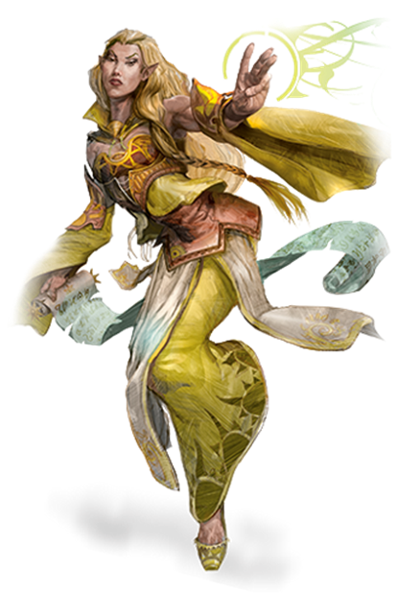
Ramora [Last Name UNKNOWN]
High Elf
Traveling Adventurer
Works Part-Time at the Day Dream Library
Extremely interested in any ancient artifact

Slide 9
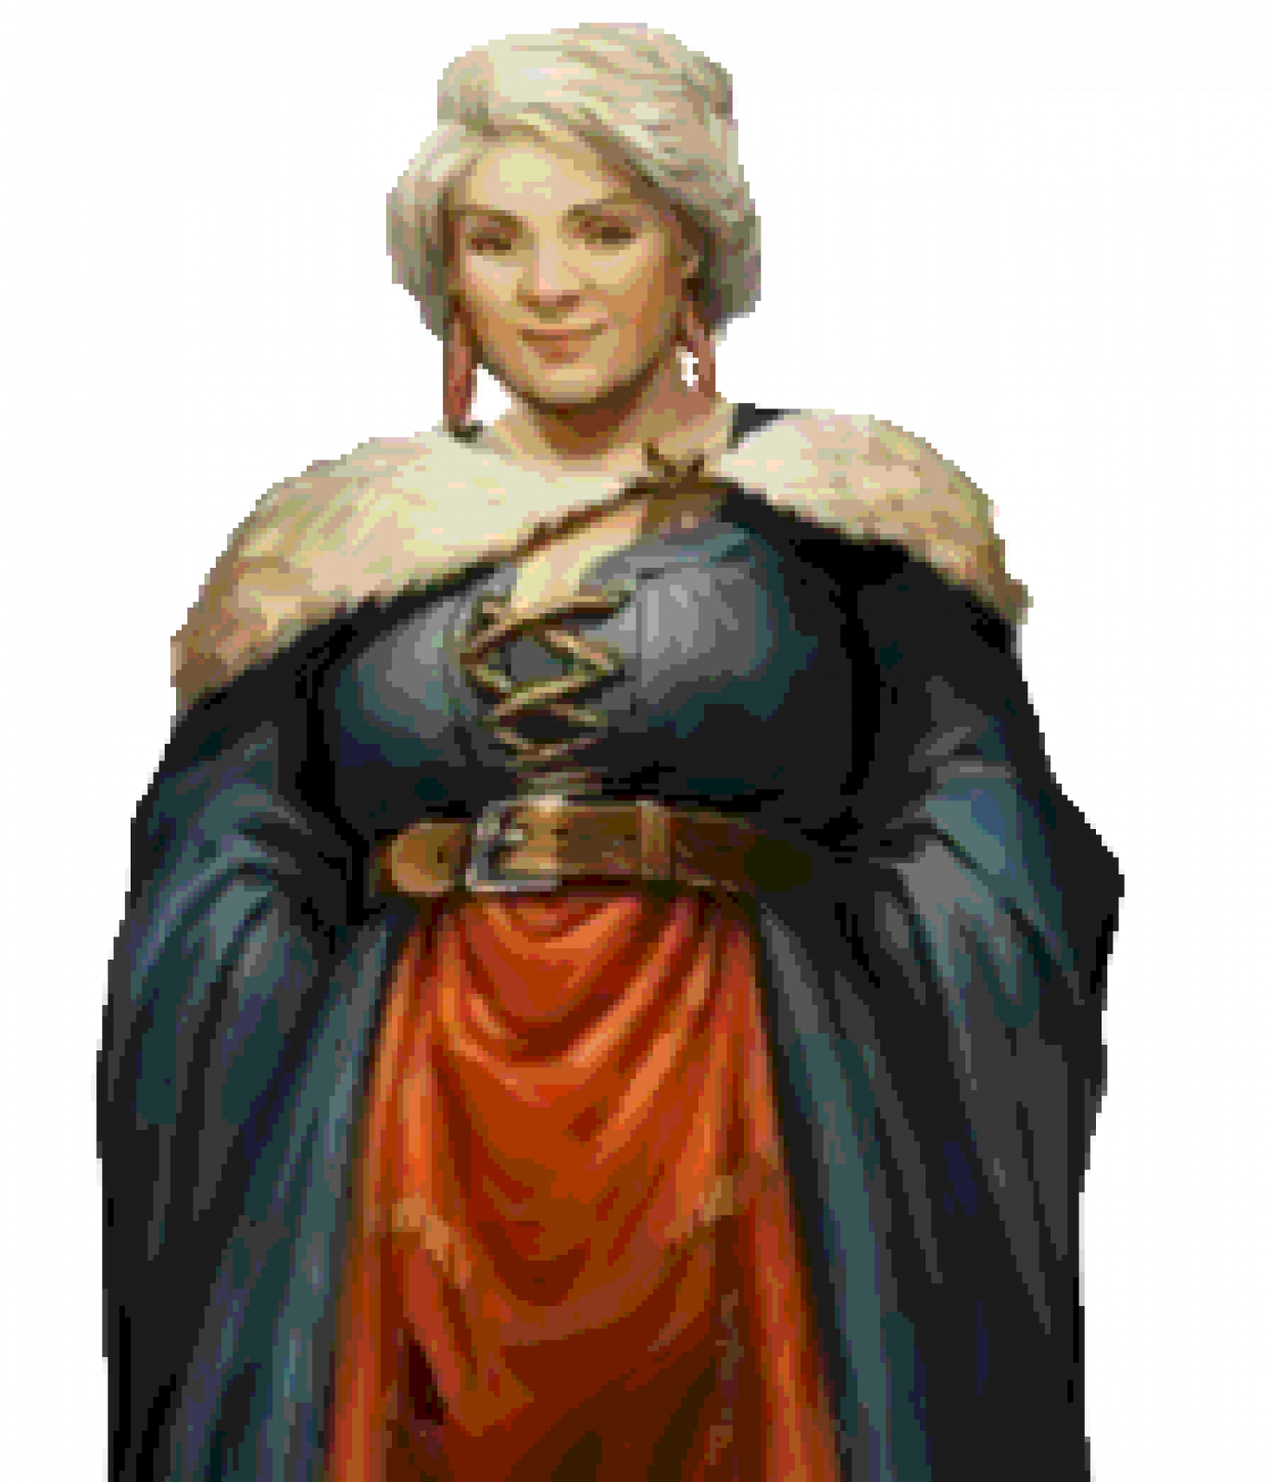
Godvia Commonbrook
Mayor of Helmfield
Her motto: “The people are first, the government is corrupt and make everyone happy!”

Slide 10
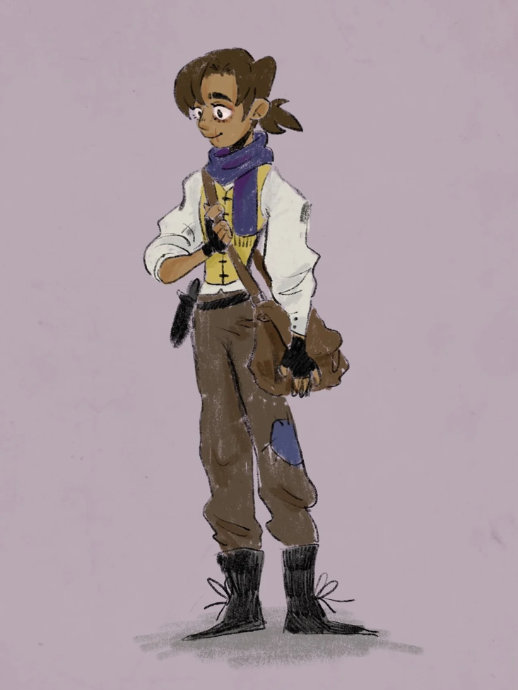
Kyle ???
Beat Rhino in Arm Wrestling due to the help of the party.
Is scared of Rhino.
Has Third Degree Burns on his right arm to his chin.

Slide 11
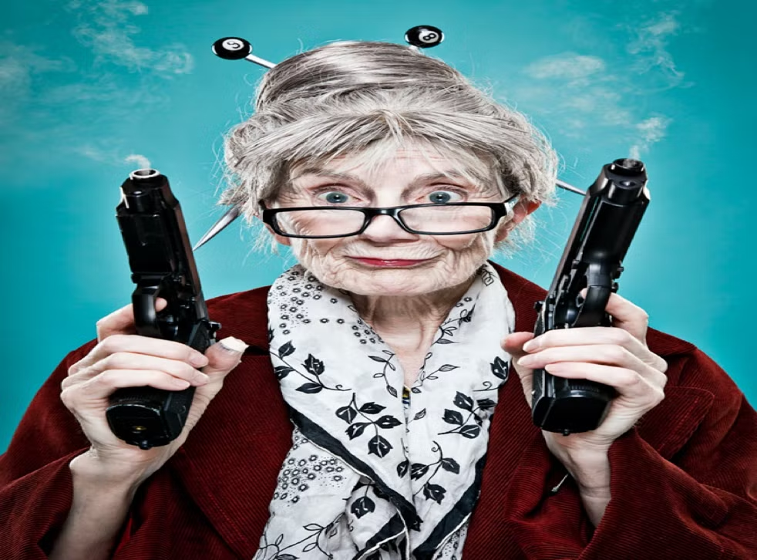
Swan [Last Name UNKNOWN]
Human
Owner of The Thoughtful Baker Bar
Extremely quick when getting drinks and food.

Slide 12
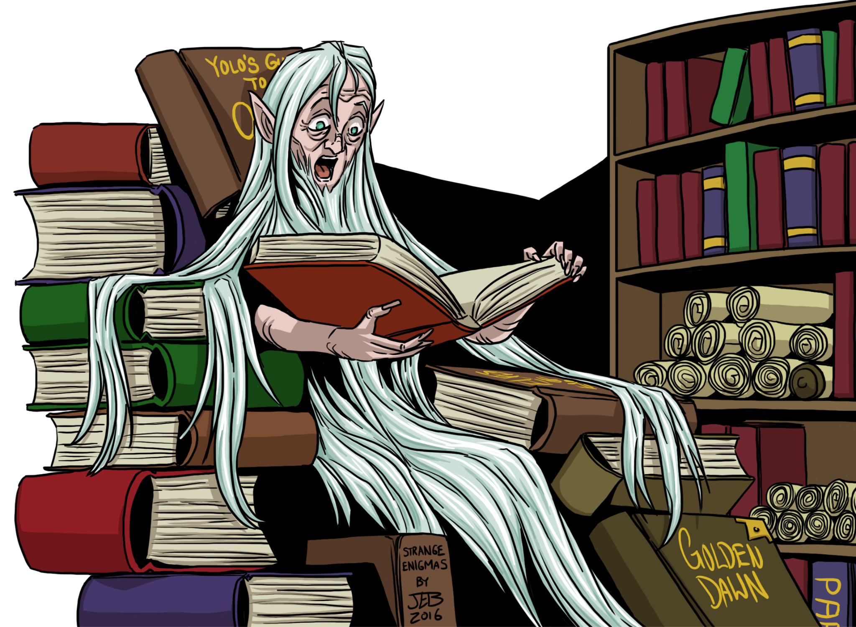
Luanda Hushbringer
Human
Owner of the Day Dream Library

